Slide 1
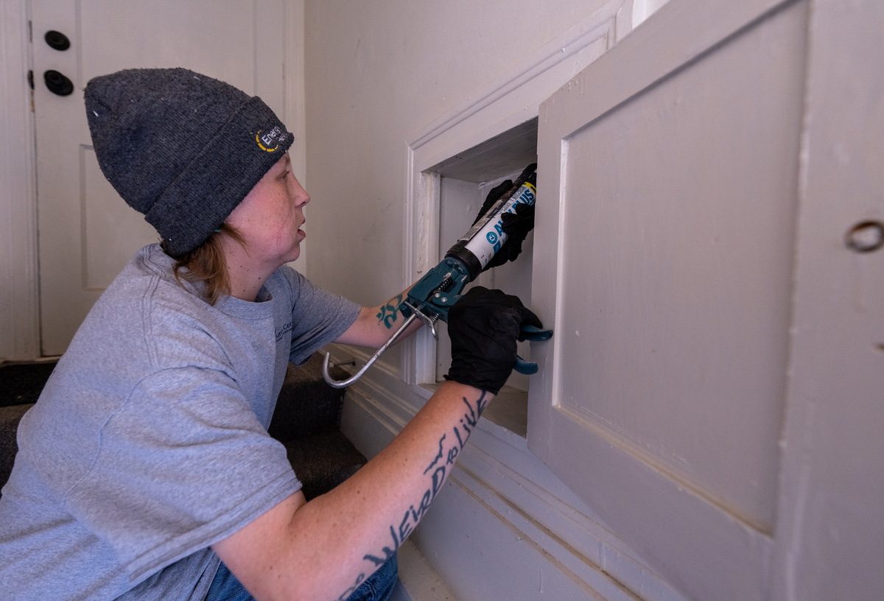

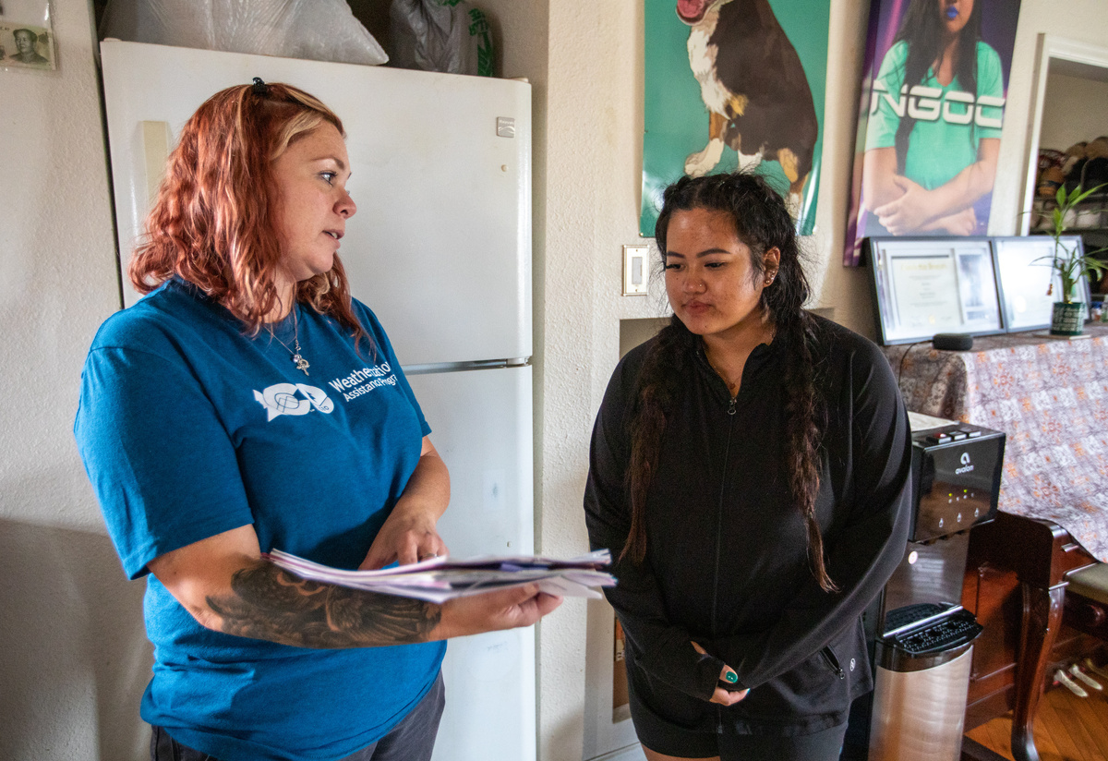
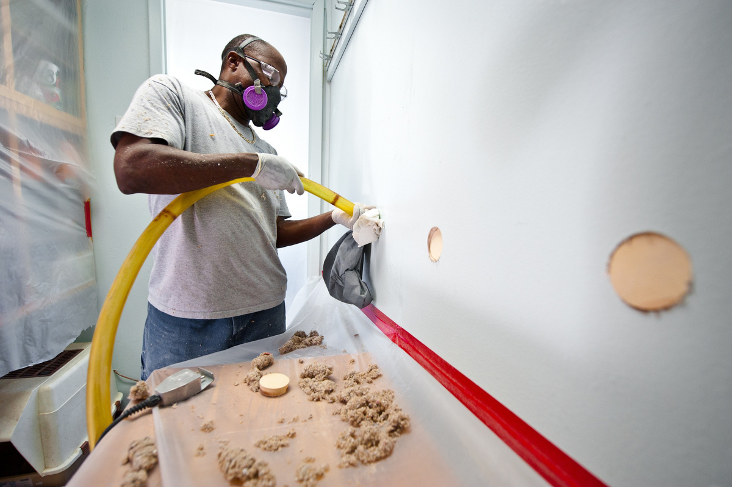
Help to Cultivate a New Generation of Weatherization Assistance Program Professionals and Contractors

Slide 2


PROBLEMS
SOLUTIONS
  Job seekers don’t know about opportunities in the Weatherization Assistance Program.
  Workforce development resources are fragmented.
  Employers need help connecting to potential employees.
  Contractors don’t know how to connect to Weatherization Assistance Program opportunities.
  Green Workforce Connect provides job seekers with a Weatherization Assistance Program career exploration tool and connects them to their local Weatherization Assistance Program employer.
  Employers access workforce development resources and technical assistance.
  Contractors access program information and resources to connect them to Weatherization Assistance Program contracting opportunities.

Slide 3

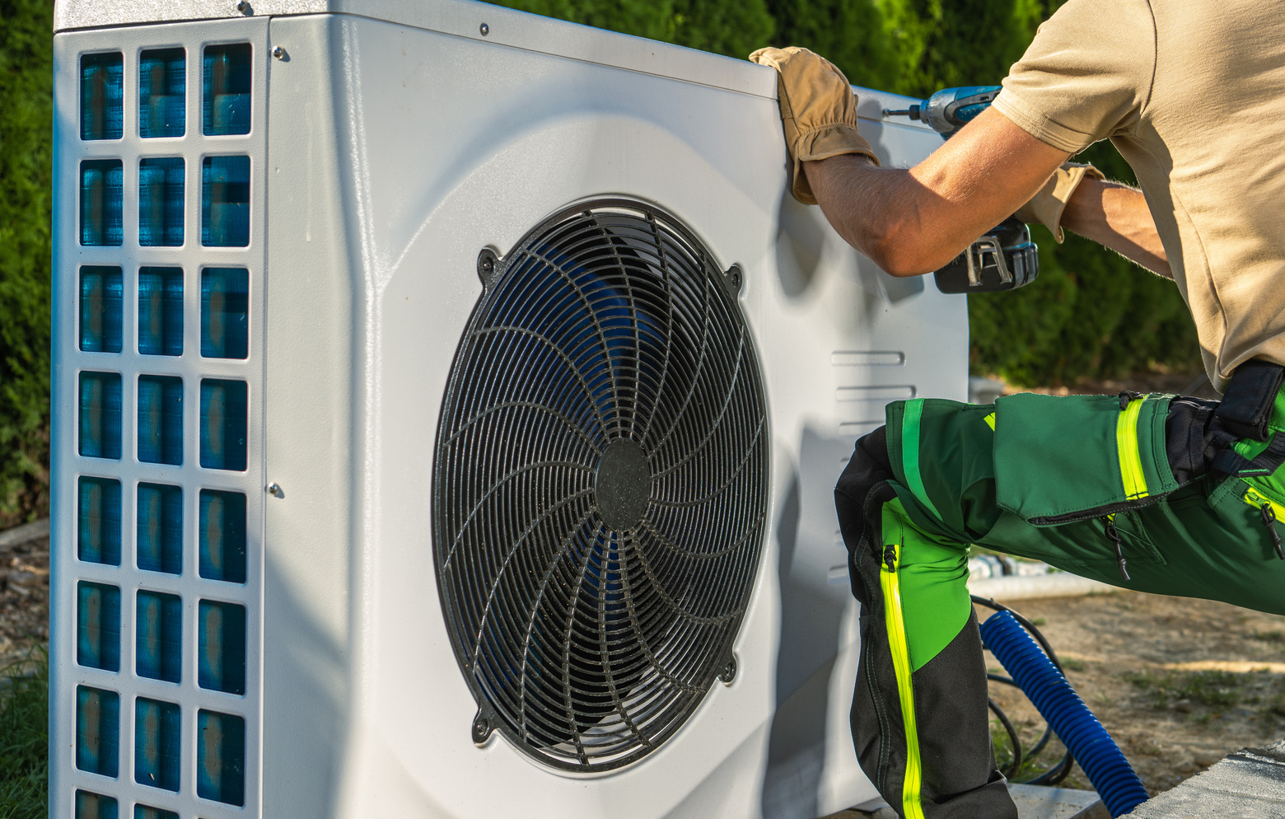


TARGET AUDIENCES
Students
Job Seekers
Career Switchers
Current Employees
I want to explore career pathways, and access scholarships, internships, apprenticeships,
OJT or other programs.
I want to learn about career pathways and connect to a
program or job opportunity.
I want to learn about career pathways, map my current skills, upskill if needed, and connect to
an employer.
I want professional development and recognition for my learning that provides me with career mobility.

Slide 4



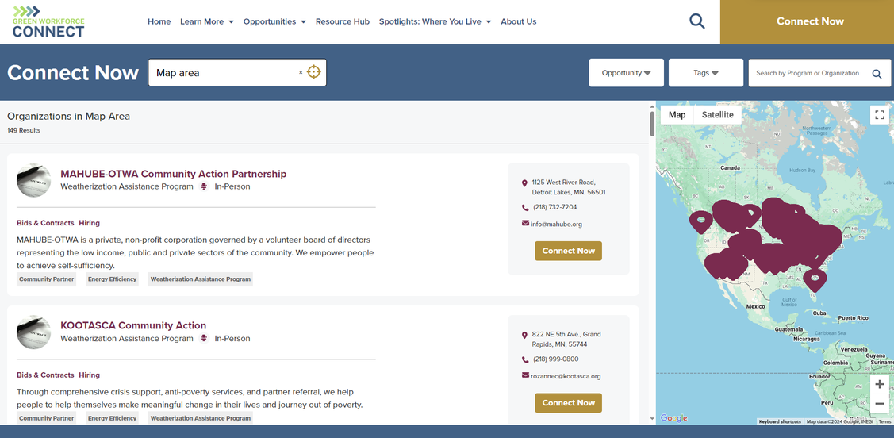
Introducing...
.org!
Job seekers will:
  Discover career pathways and explore entry points
  Access various resources
  Determine if this work is a good fit with quiz
  Connect to their local weatherization or training center

Slide 5


Take advantage of our...
Outreach Toolkit!
Raise awareness of Weatherization Assistance Program careers and invite job seekers to visit the Green Workforce Connect platform! The outreach toolkit includes dozens of template options for multiple audiences, including:
  Printable Flyers
  Printable Postcards
  Social Media Toolkit
  Radio Ads/PSA Language
  Slide Templates and Presentations
  Career Stories Featuring Weatherization Professionals

Slide 6

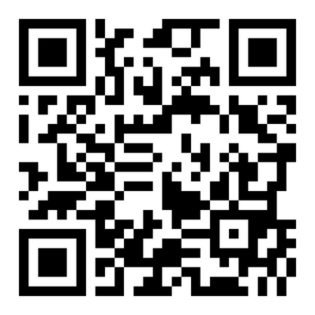
Visit Website
Stay Connected with Green Workforce Connect Updates
Photo Credits: U.S. Department of Energy, Energy Resource Center, NREL, and Pennsylvania College of Technology
This material is based upon work supported by the U.S. Department of Energy’s Office of Energy Efficiency and Renewable Energy (EERE) under the Weatherization Program Award Number DE-EE0010268. The views expressed herein do not necessarily represent the views of the U.S. Department of Energy or the United States Government.

